Slide 1
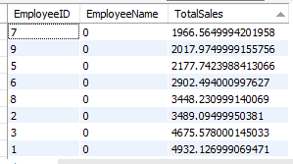
Ecommerce SQL Project
NAME: Olasode Muiz Olawale
COURSE: Data Analysis
DATE: 17/FEB/26
Q1. Total Sales by Employee:

Slide 2
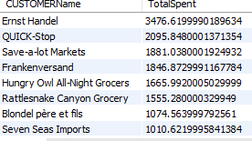

Q2. Top 5 Customers by Sales:
Q3. Monthly Sales Trend:

Slide 3
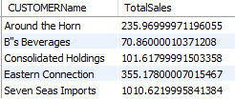
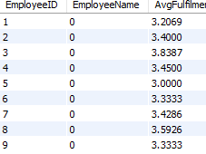
Q4. Order Fulfilment Time:
Q5. Products by Category with No Sales:

Slide 4
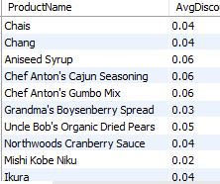

Q6. Customers with Multiple Orders on the Same Date:
Q7. Average Discount per Product:

Slide 5
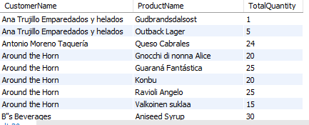
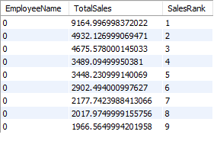
Q8. Products Ordered by Each Customer:
Q9. Products Ordered by Each Customer:

Slide 6
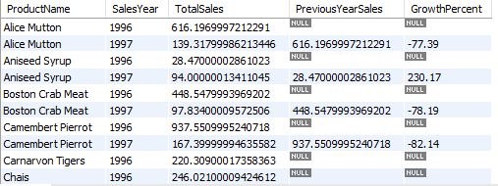
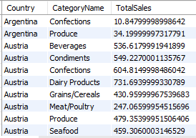
Q10. Sales by Country and Category:
Q11. Year-over-Year Sales Growth:

Slide 7
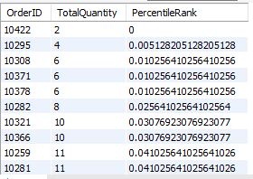

Q12. Order Quantity Percentile:
Q13. Products Never Reordered:

Slide 8
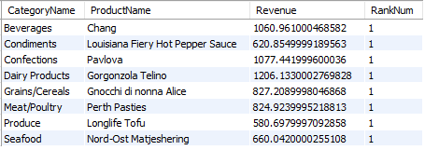

Q14. Most Valuable Product by Revenue:
Q15. Complex Order Details:

